Slide 1
Image classification using pretrained convolutional networks
Model Mavericks

Slide 2
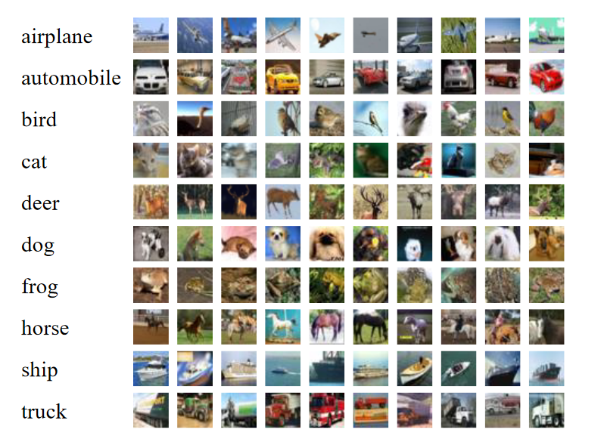
Introduction
Project Goal: Compare advantages of pretrained neural networks versus randomly initialized ones for image classification.
Key Focus: Highlight differences between pretrained and randomly initialized models
Convergence speed
Accuracy
Overall effectiveness

Slide 3
Previous Solutions
CIFAR10 is widely used as a benchmark
Many new papers, models try to use it to demonstrate capabilities (if applicable)
Current SOTA uses Vision Transformer technology (600M+ params)

Slide 4


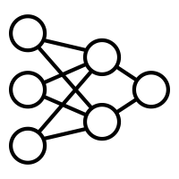

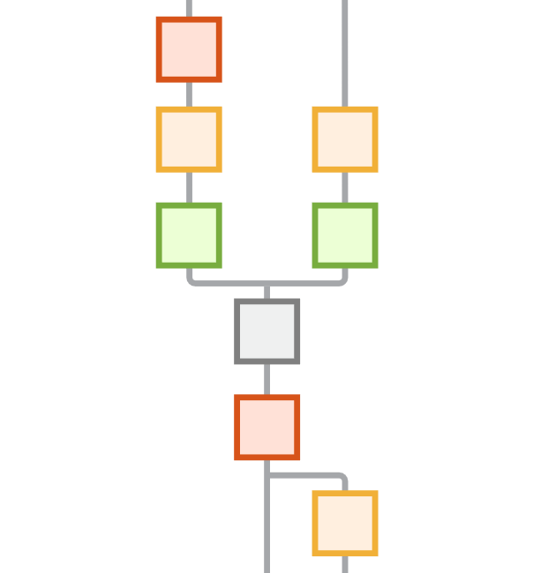



System Design
CNN from scratch
Containerization
Yupiter Notebook
Docker Compose
1.2 million parameters
MaxPooling
ResNet18
Data Processing
11 million parameters
Timm
Pytorch Tensor
Augmentation

Slide 5
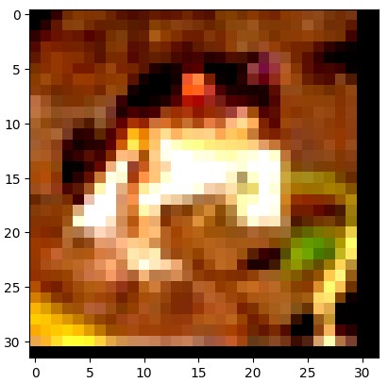
About the Data - The CIFAR-10 Database
60,000 32x32 color images, 10 classes - 6,000 images per class
Split into 50,000 training images and 10,000 test images
Augmentations:
Random crop with padding
Random horizontal flip
Conversion to PyTorch tensor
Normalization

Slide 6
Training
Manual hyperparameter-optimization
mainly LR, by factors of 10
CrossEntropyLoss (for classification)
Adam optimizer
Utilized cuda

Slide 7
Results
ResNet18
Fine-tuning
Pre-existing Knowledge
Faster accuracy convergence
Our Model
Smaller size
Randomly initiated weights
Slower convergence
Lower overall accuracy
86%
83%
ResNet18 Test Accuracy
Our Model

Slide 8
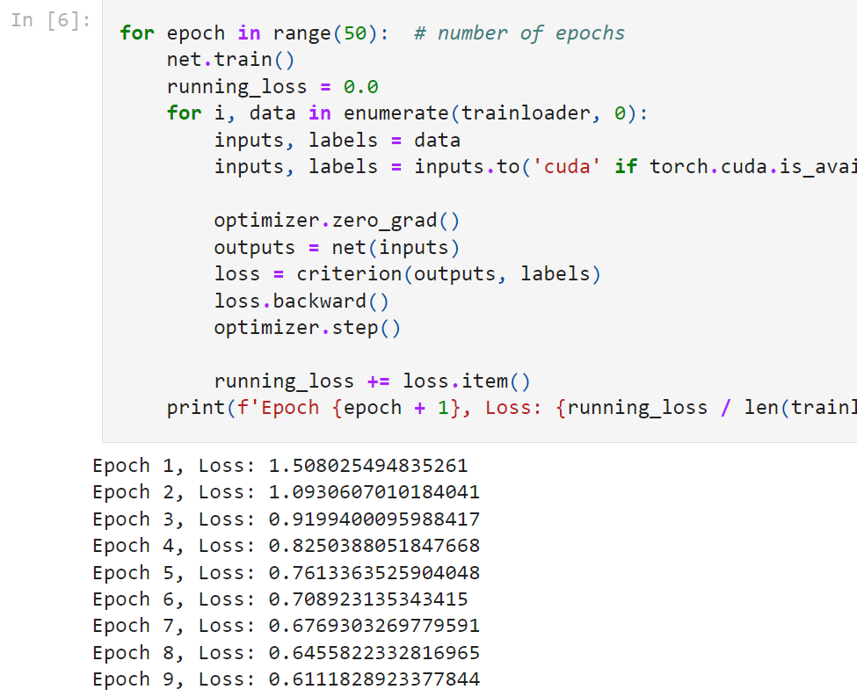
Summary
Results
Models performed as expected
Hands-on Experience with ML Tools
Insights regarding ML DevOps
Challenges
Containerisation
Version Control

